Slide 1
Minimise security breaches and system downtime
By Charlotte, Charlotte and Jake

Slide 2
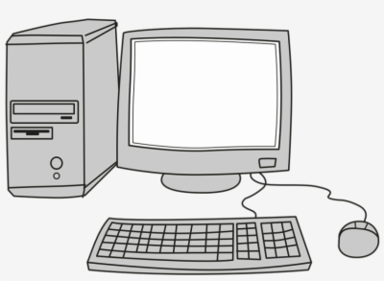
Security Breaches
A security breech can be likened to a break in on a house. In terms of security breeches in term of computing may occur if an unauthorized person gets hold of sensitive data belonging to your organization. If a security breech does occur it can damage the organizations reputation and could result in financial loss.
Types of security breeches Viruses Spyware Malware
Real life examples
Equifax security breach
Facebook security breach
Yahoo security breech

Slide 3


Firewall
Having a firewall installed can help to minimise security breeches into a system, it can filter information that enters the system and block unauthorised access with the use of a whitelist (list of authorised access) and backlist (list of unauthorised access) it also prevents against malware attacks.

Slide 4

System Software update and business
Software, whether high level or low level, should be updated regularly.
There are a few benefits to keeping software up to date, not limited to feature updates. These benefits often revolve around security.
Low level security patches – exploits and issues that allow for attacks. Example of this would be Heartbleed or ZombieLoad.
Higher level security – Issues with software like Word or Chrome that result in system instability or security risks.

Slide 5
Anti-Virus Software
Purpose? is to detect neutralize or eradicate malware
How does it work?
1st scan the computers files to seek out any viruses that fit the description in the virus dictionary
Using a method called heuristic analysis, it will also try to detect suspicious activity from any program or software that may be affected

Slide 6

System Downtime
System down time is the span of time where the system is unavailable. This occurs when a system fails or shuts down for example when a power surge/shortage occurs rendering the system unable to carry out its functions and as a result needs recovering in order for the company to operate at its full capacity.
System downtime can be minimised with the use of a good recovery plan. Having a recovery plan in place means that if that system goes down there is a procedure in place to get the system functioning as soon as possible minimising the downtime of the system.

Slide 7


Recovery plan : Server Redundancy
Server redundancy is when a replica server is created that is identical to the main server the company uses. This server is then used to store a complete back up of the main server.
Main
Back up
New York stock exchange

Slide 8
Recovery plan : backup generator/extra power source (Uninterrupted power supply)
Overview
This is a power supply that is usually placed on a site separate to where the computer network
Benefits
Emergency power supply
Maintains battery life
Huge power back up in the industries

Slide 9
Recovery plan : Business Continuity Plan
Business continuity planning involves producing solutions to potential problems, whether that involves recovery or prevention of issues.
Some solutions to large scale problems are:
Data replication
Crisis management
Backup sites
Communication architecture planning

Slide 10
References
https://www.nyse.com/data/cta
https://www.independent.co.uk/arts-entertainment/films/news/pixars-billion-dollar-delete-button-nearly-lost-toy-story-2-animation-7758083.html

